Slide 1



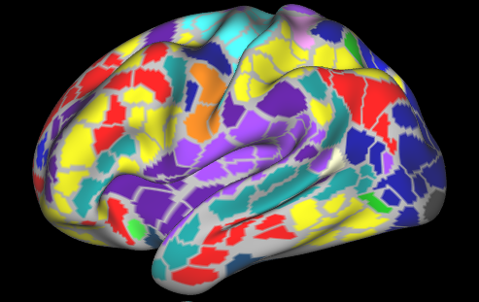
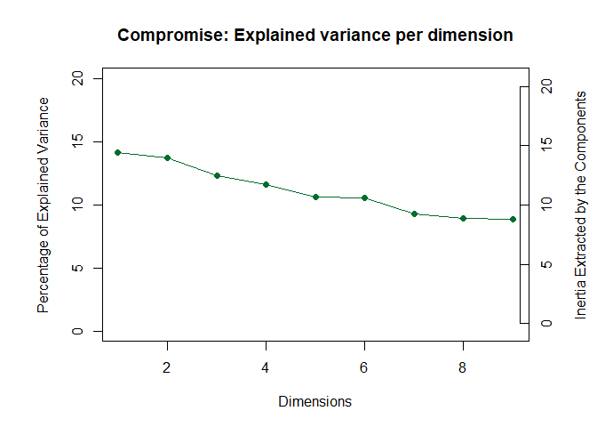
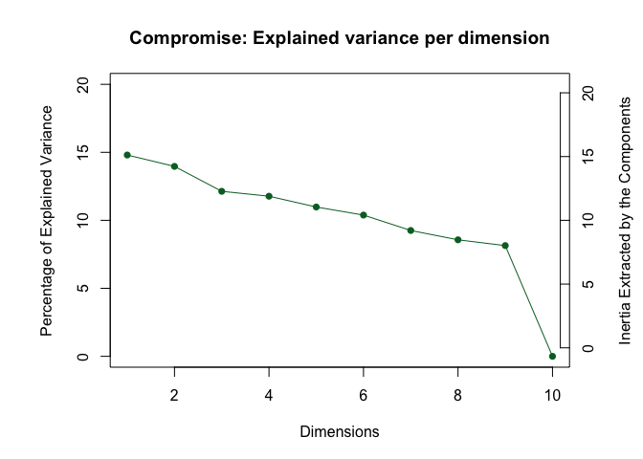
Resting-state
Ju-Chi Yu¹, Micaela Chen^{1,2}, & Hervé Abdi¹
1. School of Behavior and Brain Sciences, the University of Texas at Dallas; 2. Center of Vital Longevity, the University of Texas at Dallas
Ju-Chi.Yu@utdallas.edu, Micaela.Chen@utdallas.edu, herve@utdallas.edu
1. Question
2. Standard approaches
3. Proposed method
Motivations:
Individual can have different numbers of brain regions, brain networks, and regions within each network.
Mapping individuals to one template or an average brain could be problematic.
Important for specific fields of studies:
Aging study
Lesion study
Developmental study
Objectives—to develop a new technique that:
Keeps individual differences
Analyzes in a local, instead of an atlas, space
Allows different numbers of regions/networks
Seed-based or ICA analysis:
Compare the spatial spread of sub-networks or their mean connectivity
Network properties:
Modularity or centrality of entire network or sub-networks
The number of sub-networks (i.e., functional systems):
Lots of comparisons have to be made to identify the driving sub-networks of effects
Existing multivariate methods:
Require the matrices across subjects to be the same dimension (e.g., DISTATIS)
Recent work in resting-state analysis have started deriving subject-specific parcellations, resulting in different matrix dimensions across subjects
Midnight Scan Club (MSC) resting-state MRI data
Session 1
10 participants
10 sessions
Individual parcellation
Individual space
No template was applied
Session 2
…
…
…
…
Session 10
Gordon, E. M., Laumann, T. O., Gilmore, A. W., Newbold, D. J., Greene, D. J., Berg, J. J., ... & Hampton, J. M. (2017). Precision functional mapping of individual human brains. Neuron, 95(4), 791-807.
…
…
…
…
For each session of each participants:
Only the common network across participants were selected and analyzed actively.
Negative and perfect z-transformed correlations were excluded from the analysis.
Subj 1
Subj 2
Subj 3
…...
Subj N
Parcel’s mean time series during resting-state scan
Cross correlation between parcels
Session 1
Session 2
Fisher’s Z transformation
…
Session 10
Frames
preprocessed
SVD
6. Results
7. Discussion
4. Connectivity data
 | Dimensions | Preprocessing | Scree plot | Sessions factor scores | Subject-network factor scores | Map in the brain
1 | z-matrices | x
 | rows | x
 | columns | centered
 | edge tables | x
 | subject tables | MFA-normalized
2 | z-matrices | x
 | rows | x
 | columns | centered
 | edge tables | HMFA-normalized (edge → subject)
 | subject tables
3 | z-matrices | double-centered
 | rows | x
 | columns | centered
 | edge tables | x
 | subject tables | MFA-normalized
4 | z-matrices | x
 | rows | x
 | columns | centered
 | edge tables | HMFA-normalized (edge → subject)
 | subject tables
5. Preprocessing
Double-centering the z matrix: exclude the correlation magnitudes of regions
Centering: exclude effects from the magnitudes
Normalization: exclude units
MFA-normalization: equalize contribution to the first component

Slide 2
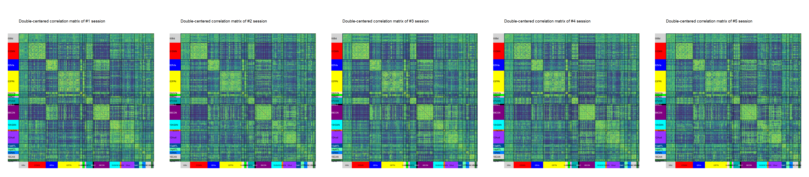
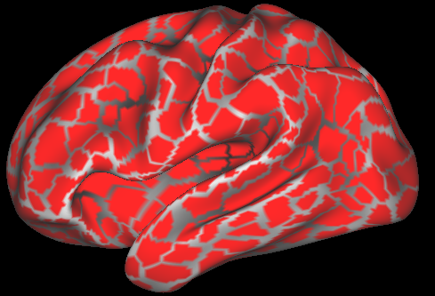
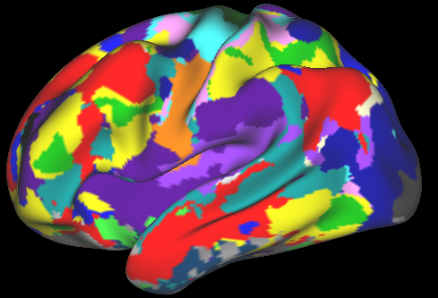
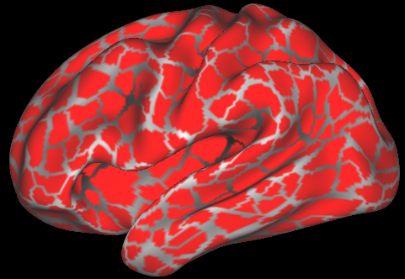
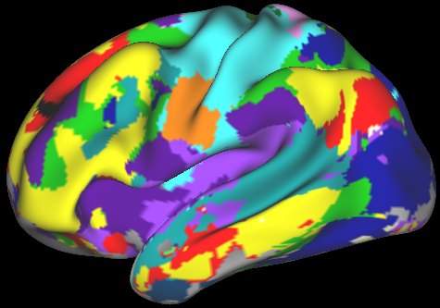
Resting-state
Ju-Chi Yu¹, Micaela Chen^{1,2}, & Hervé Abdi¹
1. School of Behavior and Brain Sciences, the University of Texas at Dallas; 2. Center of Vital Longevity, the University of Texas at Dallas
Ju-Chi.Yu@utdallas.edu, Micaela.Chen@utdallas.edu, herve@utdallas.edu
1. Introduction
3. Proposed method
Background
Recent work in resting-state fMRI (rsfMRI) analysis can derive subject-specific parcellations and sub-networks.
Standard approaches for rsfMRI:
Graph/network analysis accommodates different number of parcels/sub-networks, but requires correction for multiple comparisons when examining sub-networks.
Multivariate analysis (e.g., MDS, DISTATIS) requires same number of parcels and sub-networks usually achieved by using a shared template.
However, this approach biases against individuals that varies greater from the target template.
The above issues from standard approaches are particularly problematic for studies involving subjects that exhibit larger variance in brain structure and function (e.g., elderly, lesion patients, children).
Aim
Develop a new multivariate technique that allow different number of parcels/sub-networks.
Session 1
Session 2
…
…
…
…
Common Sub-networks
Dorsal Attention
Ventral attention
Session 10
Default
Visual
Frontal-parietal control
Mouth somato-motor
Auditory
Cingulo-opercular control
Hand somato-motor
…
…
…
…
Session 1
Subj 1
Subj 2
Subj 3
…...
Subj N
Session 2
…
Session 10
preprocessed
SVD
6. Results
7. Discussion
 | Dimensions | Preprocessing | Scree plot | Sessions factor scores | Subject-network factor scores | Map in the brain
1 | z-matrices | x
 | rows | x
 | columns | centered
 | edge tables | x
 | subject tables | MFA-normalized
2 | z-matrices | x
 | rows | x
 | columns | centered
 | edge tables | HMFA-normalized (edge → subject)
 | subject tables
3 | z-matrices | double-centered
 | rows | x
 | columns | centered
 | edge tables | x
 | subject tables | MFA-normalized
4 | z-matrices | x
 | rows | x
 | columns | centered
 | edge tables | HMFA-normalized (edge → subject)
 | subject tables
5. Preprocessing
Double-centering the z matrix: exclude the correlation magnitudes of regions
Centering: exclude effects from the magnitudes
Normalization: exclude units
MFA-normalization: equalize contribution to the first component
2. Data
Midnight Scan Club (MSC; Gordon et al, 2017)
Resting-state fMRI (30 minutes)
10 participants x 10 sessions
Subject-specific parcellation and networks
Parcellation
Sub-networks
Parcellation
Sub-networks
MSC01
MSC07
Parcel’s mean time series during resting-state scan
Cross correlation between parcels
Fisher’s Z transformation
Frames
Extract time series and create correlation matrix for each session of each subject

